Slide 1

Asian American College Access Landscapes

Slide 2
Overview
Research Question
Literature Review
Framework
Methodology and Data
Analysis
Findings and Conclusions
Implications

Slide 3
Research Question
What are the different experiences of Asian American ethnic groups across Philadelphia and their access to higher education.

Slide 4
Literature Review
Asian American Geography
Liu's (2018) ethnography highlights the differences in Asian American perspectives, they built a framework that includes three parts.
discourse on Xi Jinping's "Chinese Dream," which emphasizes class advancement
ethnic empowerment through market liberalization
expansion of, specifically, Chinese capital.
Asian Americans in the San Gabriel Valley which fundamentally reshaped the ethnoburb (Cheng, 2013)
In Chan’s (2017), study on geographic differences in being Asian American the theme of race as a social identity was broken updivided into four subthemes:
distancing racial identity,
the strategic use of racial identity,
shifting experiences of race and racial identity to describe the importance of students' hometowns and high schools
how they now felt about their racial context.

Slide 5
Asian American Categorization
(Nadal, 2019) Historic representations of Asian Americans.
Globalization factors
Vietnam War
Korean War
Chinese Cultural Revolution
South Asian | Southeast Asian | East Asian | Filipino
Asian Indian | Burmese | Chinese | Filipino
Bangladeshi | Cambodian | Taiwanese
Bhutanese | Hmong | Japanese
Nepalese | Indonesian | Korean
Pakistani | Laotian | Mongolian
Sri Lankan | Malaysian | Thai

Slide 6
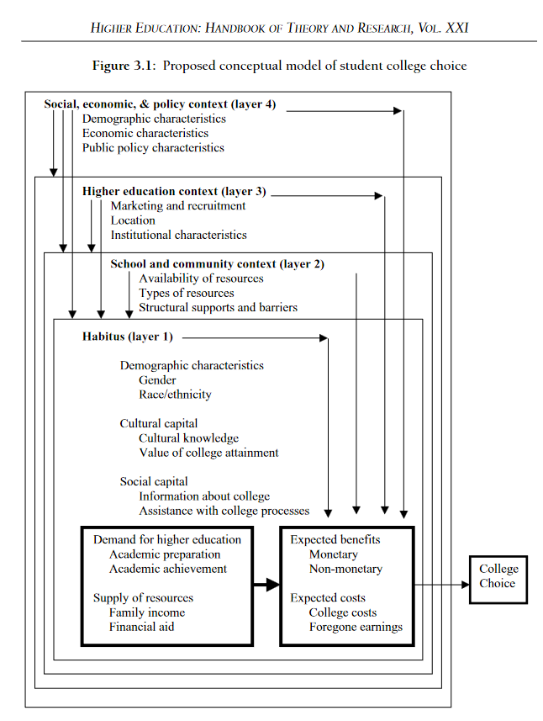
College Access Frameworks
Perna (2006) offers a conceptual model of higher education which encompasses four layers:
habitus,
school and community context,
higher education context,
social, economic and policy context.

Slide 7
School and Community Contexts
Reflects notion of “organizational habitus”
How social structures and resources facilitate or impede college choice
Supply of Resources
Family Income
Not consistently established, but research shows that family income is an important role of college choice
Family Education
Parents’ education in relationship to disposition to college attainment

Slide 8
Education
Education
No_schooling_completed | Some_HS_or_less
Nursery_school | Some_HS_or_less
Kindergarten | Some_HS_or_less
1st_grade | Some_HS_or_less
2nd_grade | Some_HS_or_less
3rd_grade | Some_HS_or_less
4th_grade | Some_HS_or_less
5th_grade | Some_HS_or_less
6th_grade | Some_HS_or_less
7th_grade | Some_HS_or_less
8th_grade | Some_HS_or_less
9th_grade | Some_HS_or_less
10th_grade | Some_HS_or_less
11th_grade | Some_HS_or_less
12th_grade,_no_diploma | Some_HS_or_less
Regular_high_school_diploma | High_School_No_Bachelor
GED_or_alternative_credential | High_School_No_Bachelor
Some_college,_less_than_1_year | High_School_No_Bachelor
Some_college,_1_or_more_years,_no_degree | High_School_No_Bachelor
Associate's_degree | High_School_No_Bachelor
Bachelor's_degree | Bachelor_more
Master's_degree | Bachelor_more
Professional_school_degree | Bachelor_more
Doctorate_degree | Bachelor_more
American Community Survey (ACS) 2019

Slide 9
Racial Ethnic Groupings
Asian Ethnicity
Asian_Indian | South_Asian
Bangladeshi | South_Asian
Bhutanese | South_Asian
Burmese | Southeast_Asian
Cambodian | Southeast_Asian
Chinese,_except_Taiwanese | East_Asian
Filipino | Filipino
Hmong | Southeast_Asian
Indonesian | Southeast_Asian
Japanese | East_Asian
Korean | East_Asian
Laotian | Southeast_Asian
Malaysian | Southeast_Asian
Mongolian | East_Asian
Nepalese | South_Asian
Okinawan | okinwan
Pakistani | South_Asian
Sri_Lankan | South_Asian
Taiwanese | East_Asian
Thai | East_Asian
American Community Survey (ACS) 2019

Slide 10
Income
Income
Less_than_$10,000 | Less_$50k
$10,000_to_$14,999 | Less_$50k
$15,000_to_$19,999 | Less_$50k
$20,000_to_$24,999 | Less_$50k
$25,000_to_$29,999 | Less_$50k
$30,000_to_$34,999 | Less_$50k
$35,000_to_$39,999 | Less_$50k
$40,000_to_$44,999 | Less_$50k
$45,000_to_$49,999 | Less_$50k
$50,000_to_$59,999 | $50-$99k
$60,000_to_$74,999 | $50-$99k
$75,000_to_$99,999 | $50-$99k
$100,000_to_$124,999 | $100+K
$125,000_to_$149,999 | $100+K
$150,000_to_$199,999 | $100+K
$200,000_or_more | $100+K
American Community Survey (ACS) 2019

Slide 11
Process
Identify if variables are spatially autocorrelated (Moran’s I)
If variables are autocorrelated, identify local indices of spatial autocorrelation (LISA)
Filter the data to identify census tracts that are high frequency and highly clustered
Identify tracts that are unique to each panethnic group
I want to identify unique panethnic experiences
Apply Kruskal-Wallis test to determine if the means are all the same
If the means are not the same, apply Pairwise Wilcox test to determine which groups are different

Slide 12
List of Methods: Spatial Methods
Moran’s I
Local Indicator of Spatial Association (LISA)
Moran’s I has been widely used to test for spatial autocorrelation or spatial dependencies and its value determines the strength of autocorrelation indicating how clustered values are.
Values that are closer to 1 indicate strong positive autocorrelation, while values closer to -1 indicate negative autocorrelation that being how repelled values are. Conversely, if values are positively autocorrelated they are spatially clustered. If the value is close to 0, then there is no spatial autocorrelation, indicating a random pattern.
the LISA for each observation gives an indication of the extent of significant spatial clustering of similar values around that observation and
the sum of LISAs for all observations is proportional to a global indicator of spatial association.The LISA we will be looking at is Moran’s I at a local level for each point. In our case each census block calculated individually and then summed to provide the I in the Moran's I.

Slide 13
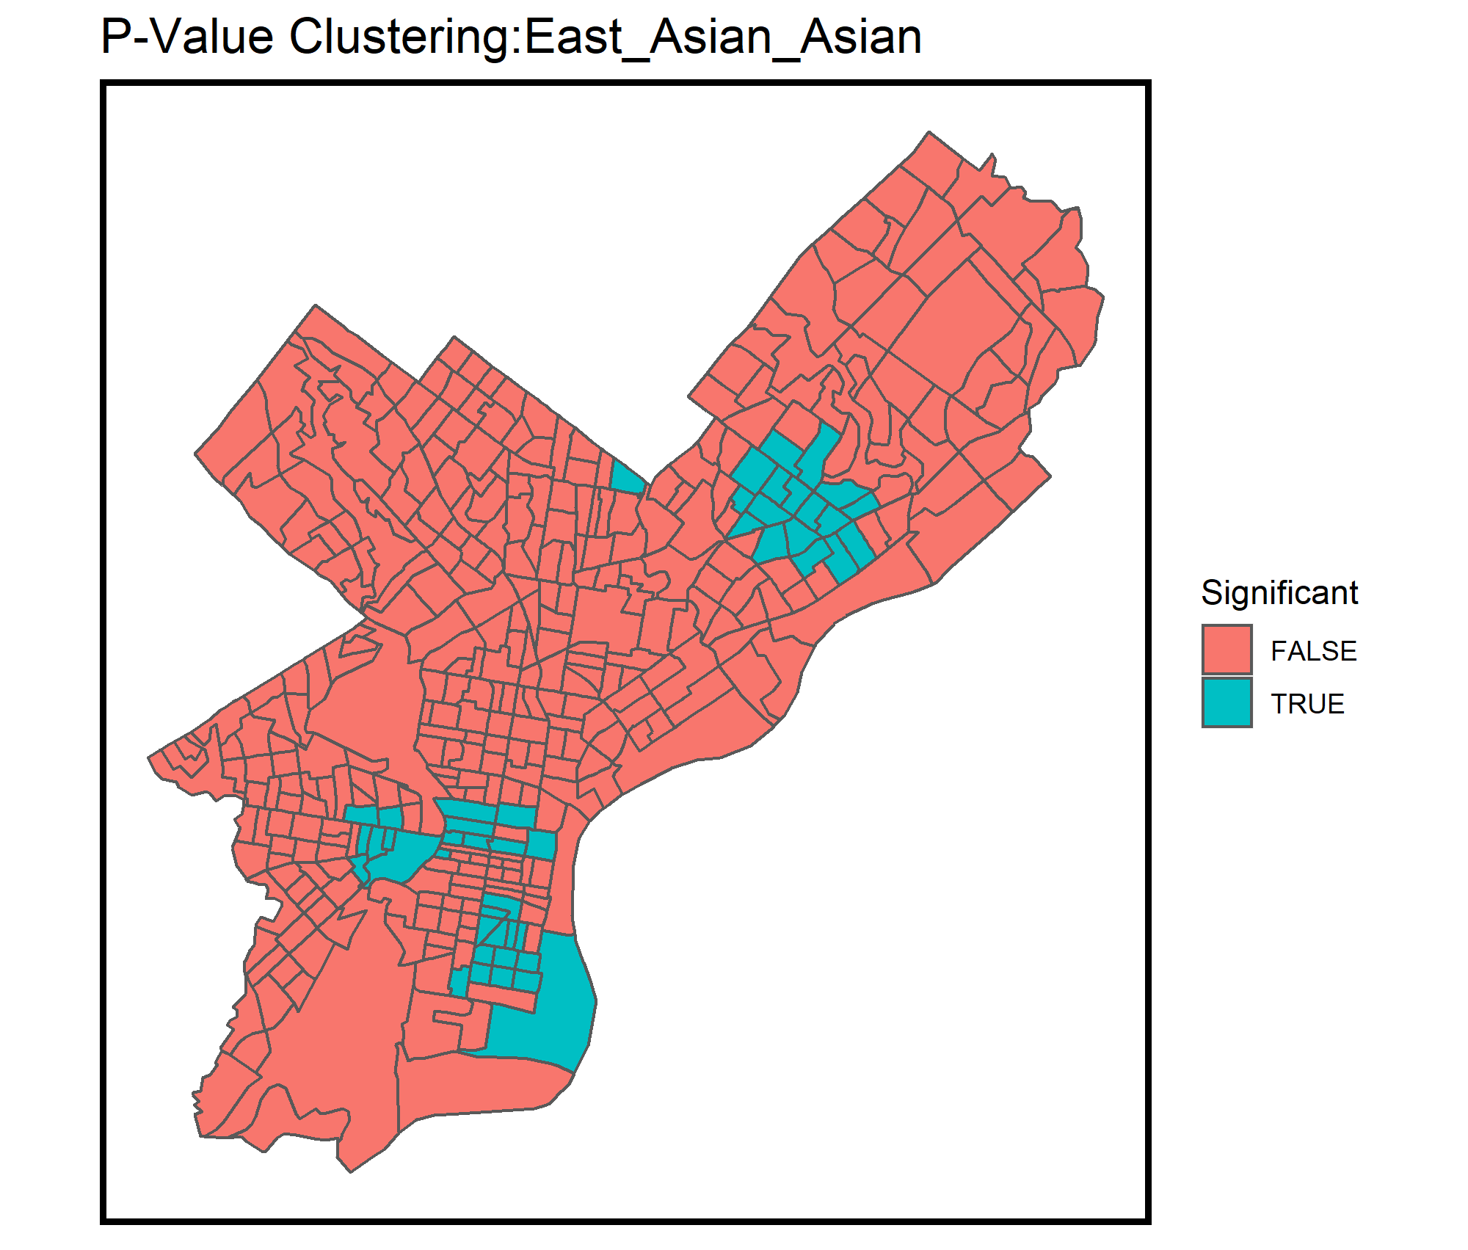
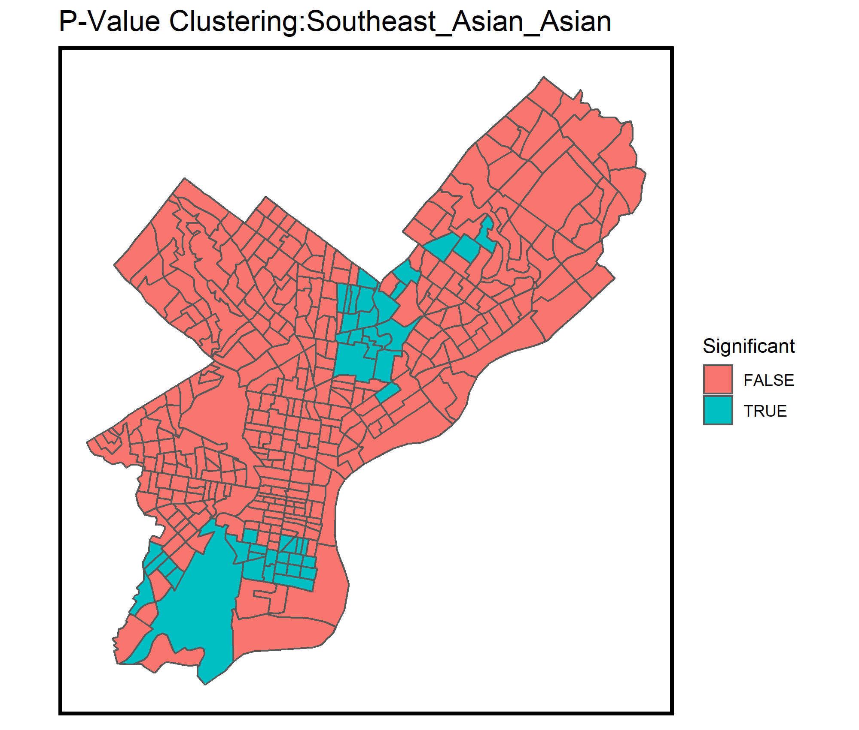
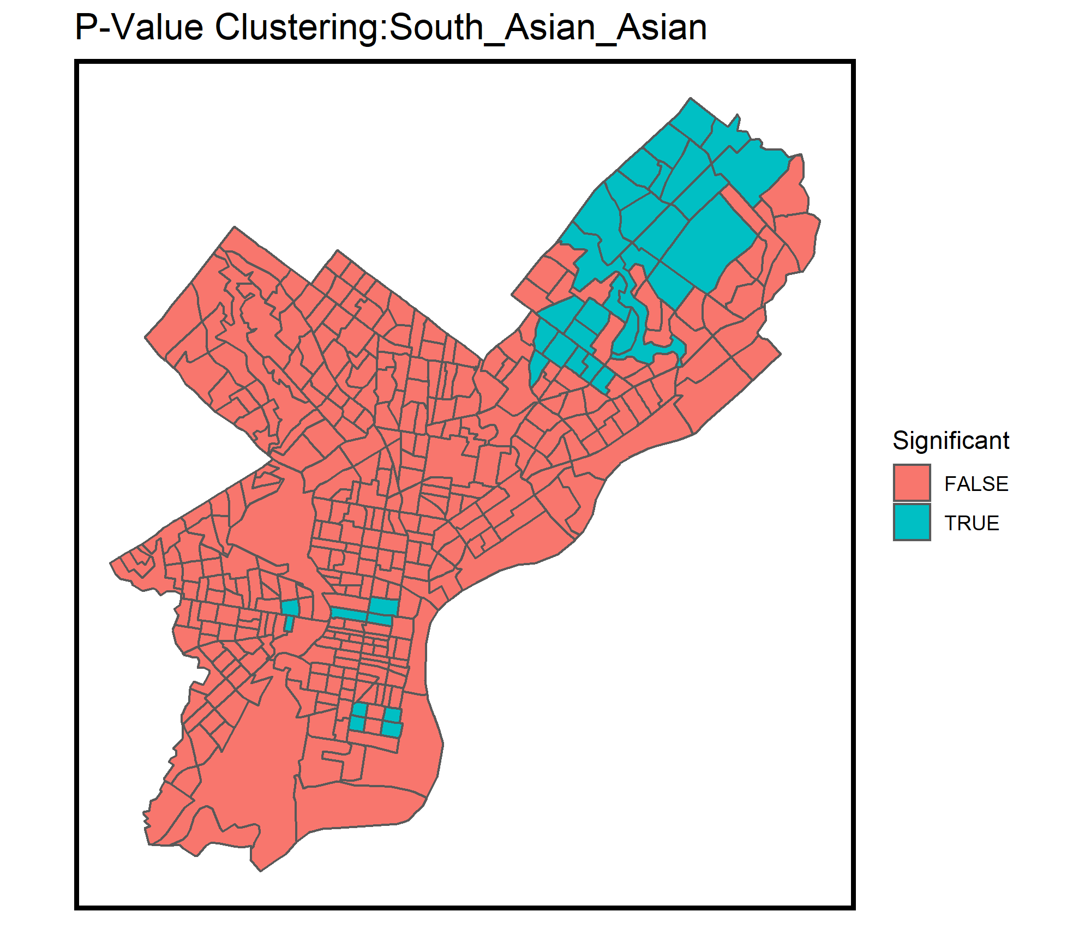
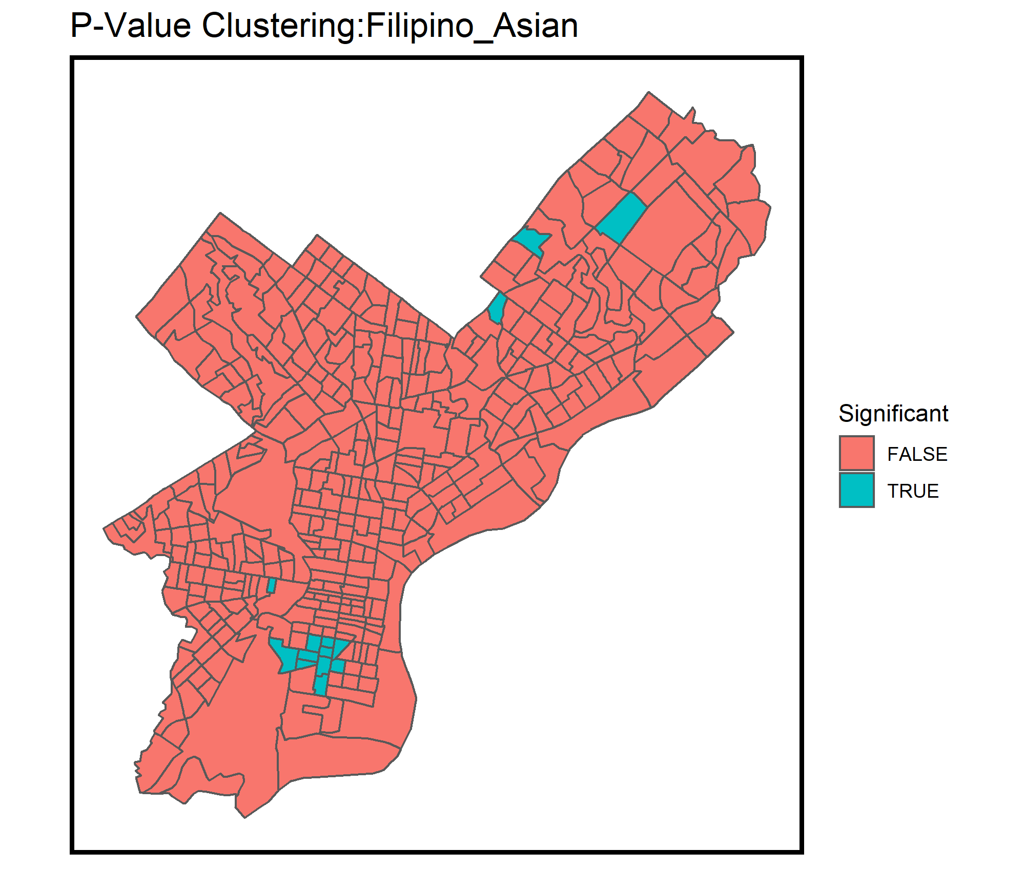
Moran’s I
Are Asian Americans Clustered?
Asian American PanEthnic Group Clustering
P-values < 0.05

Slide 14
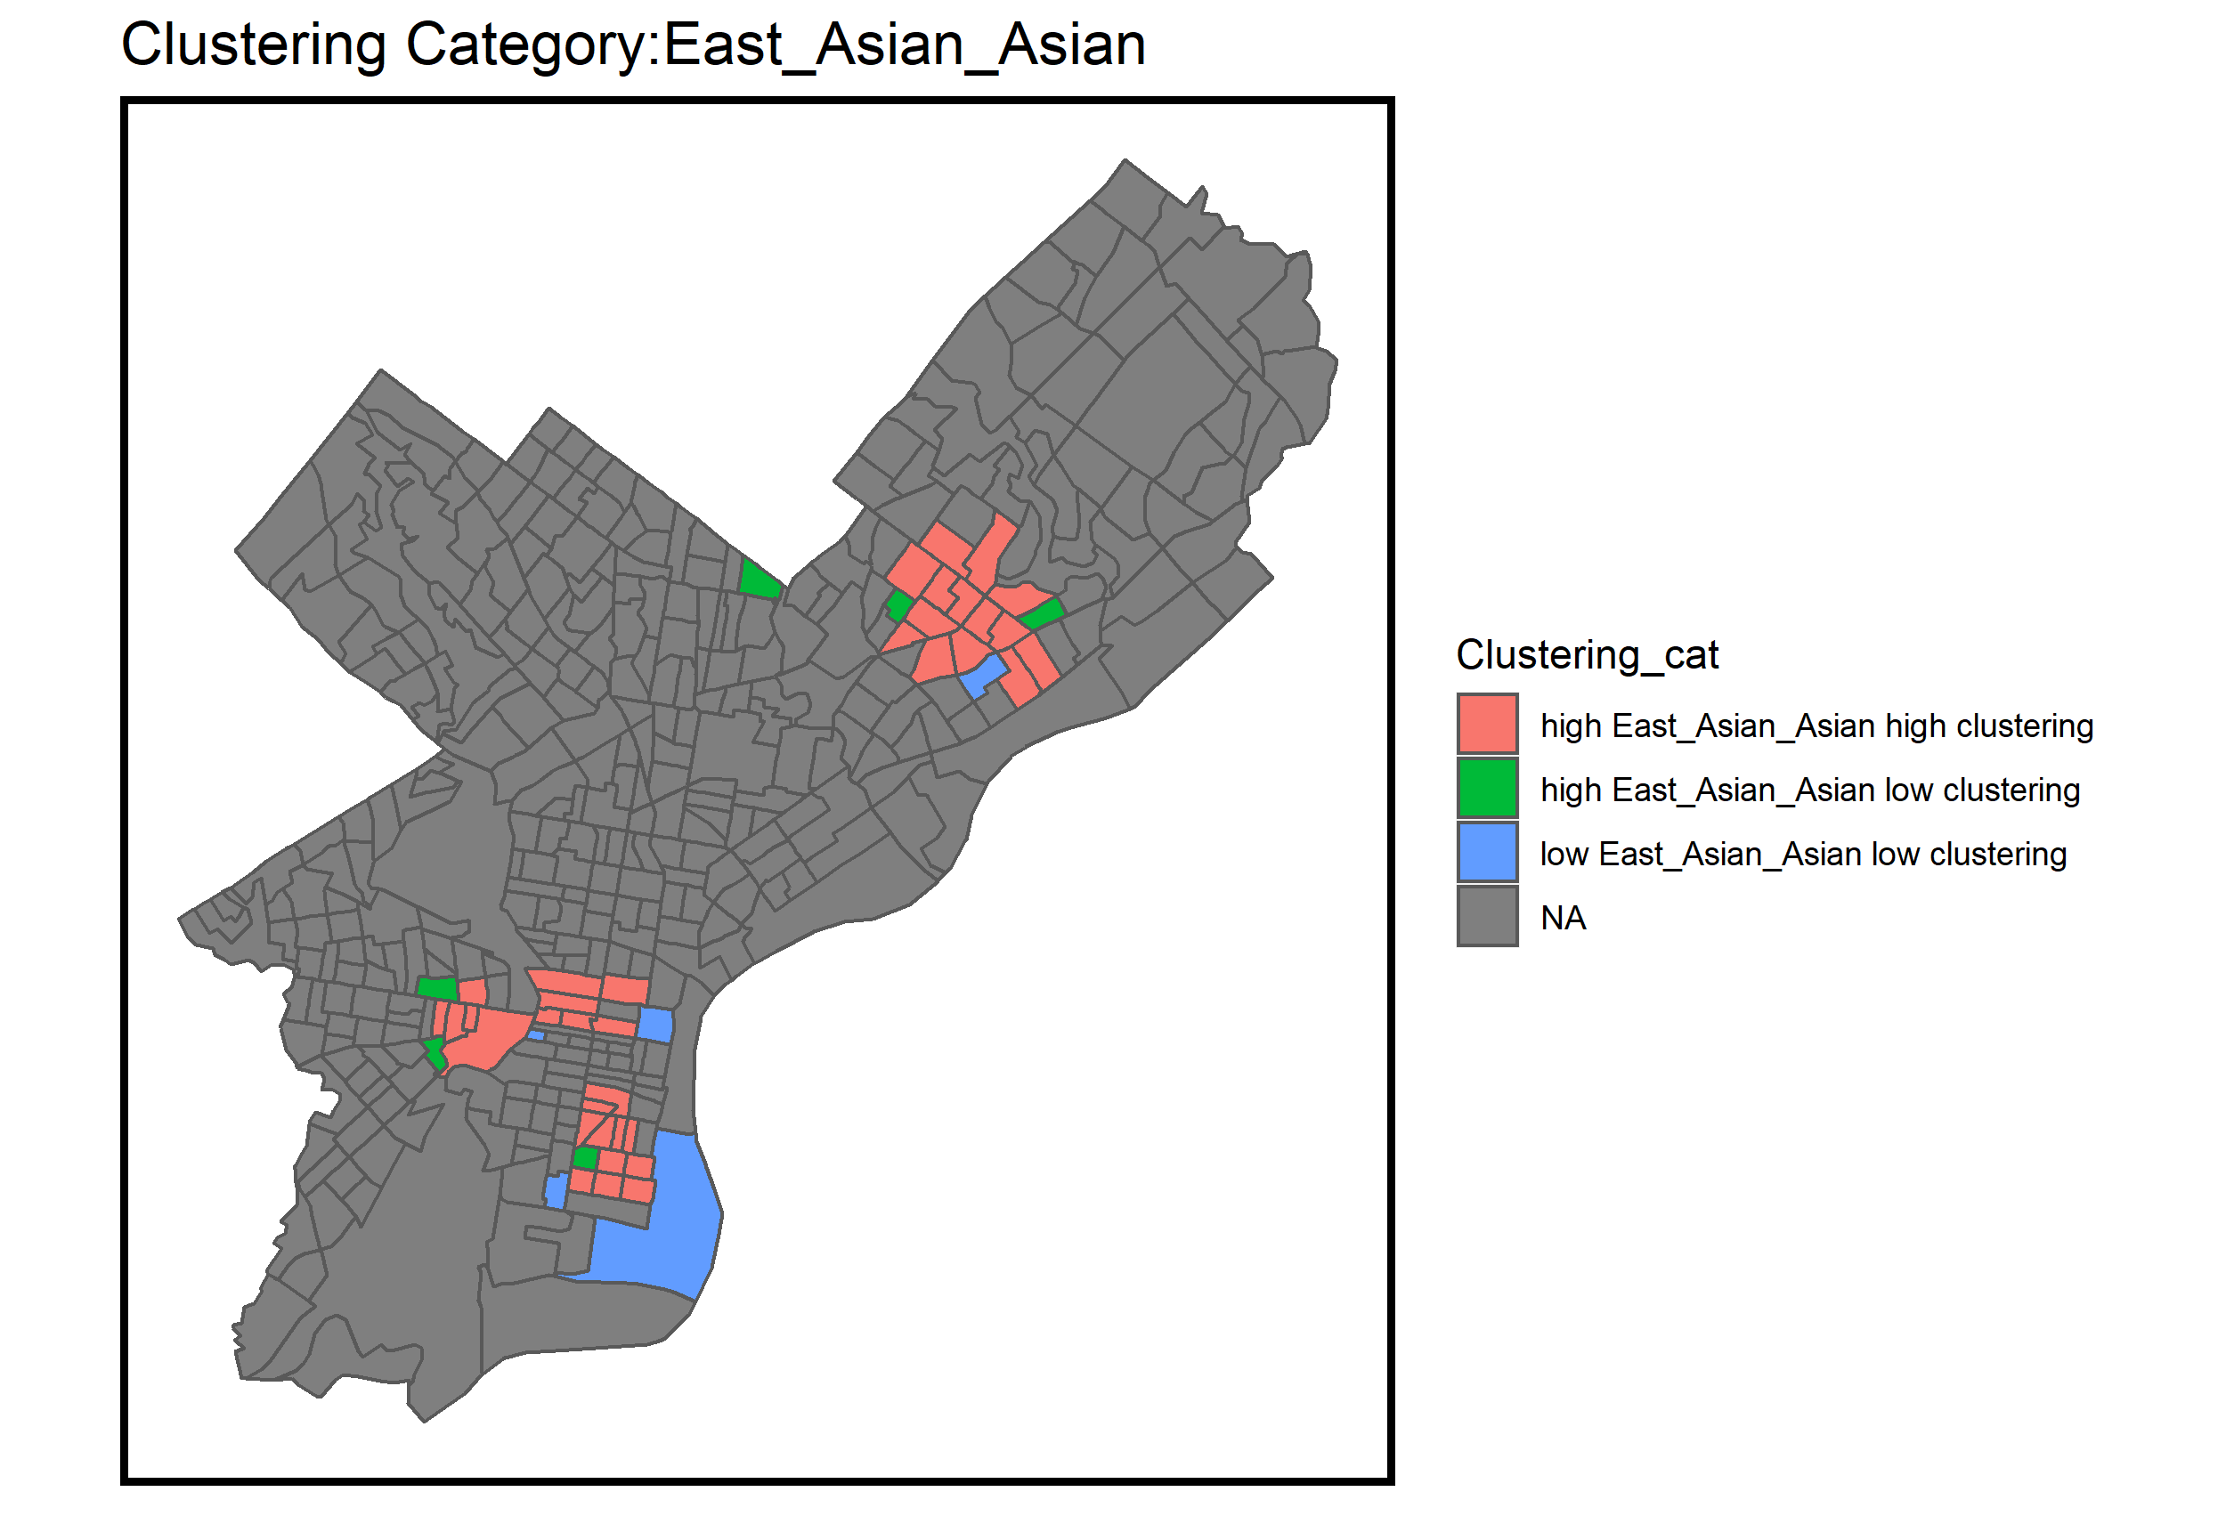
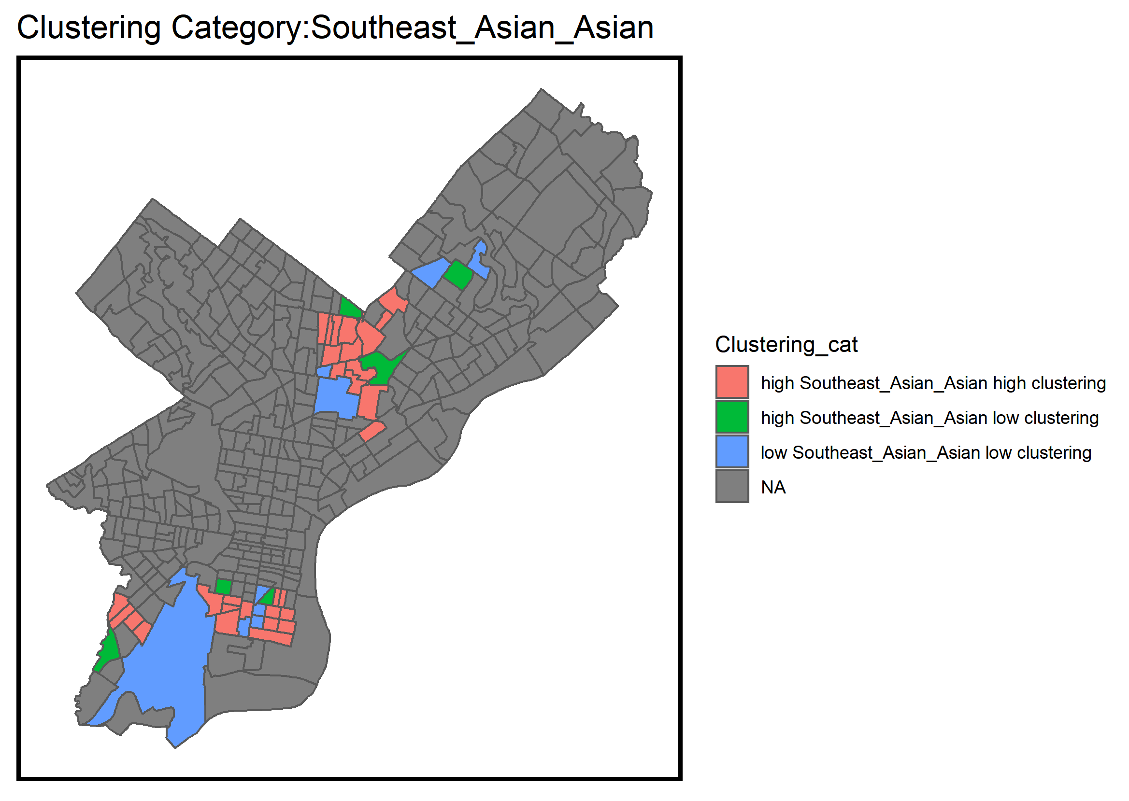
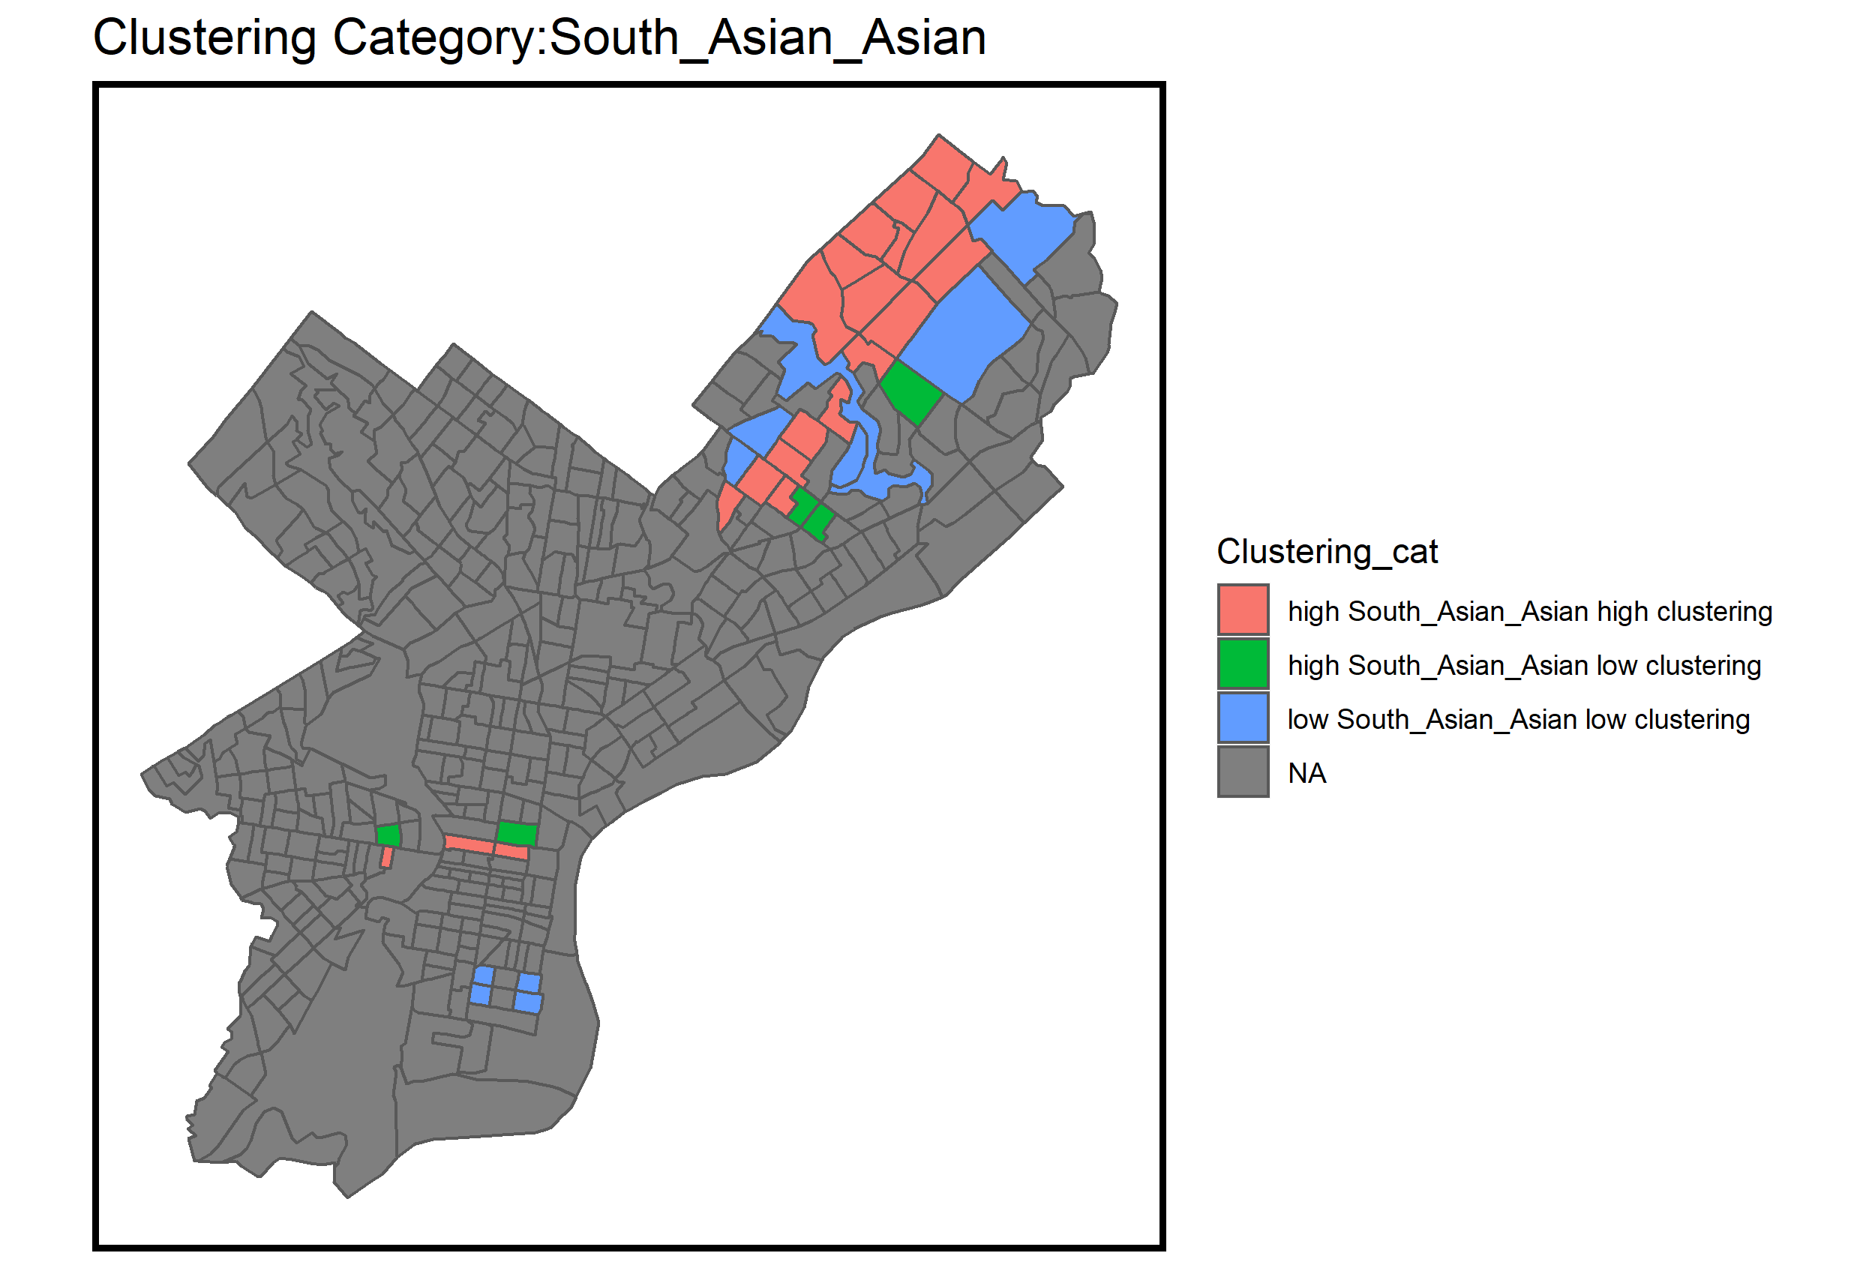
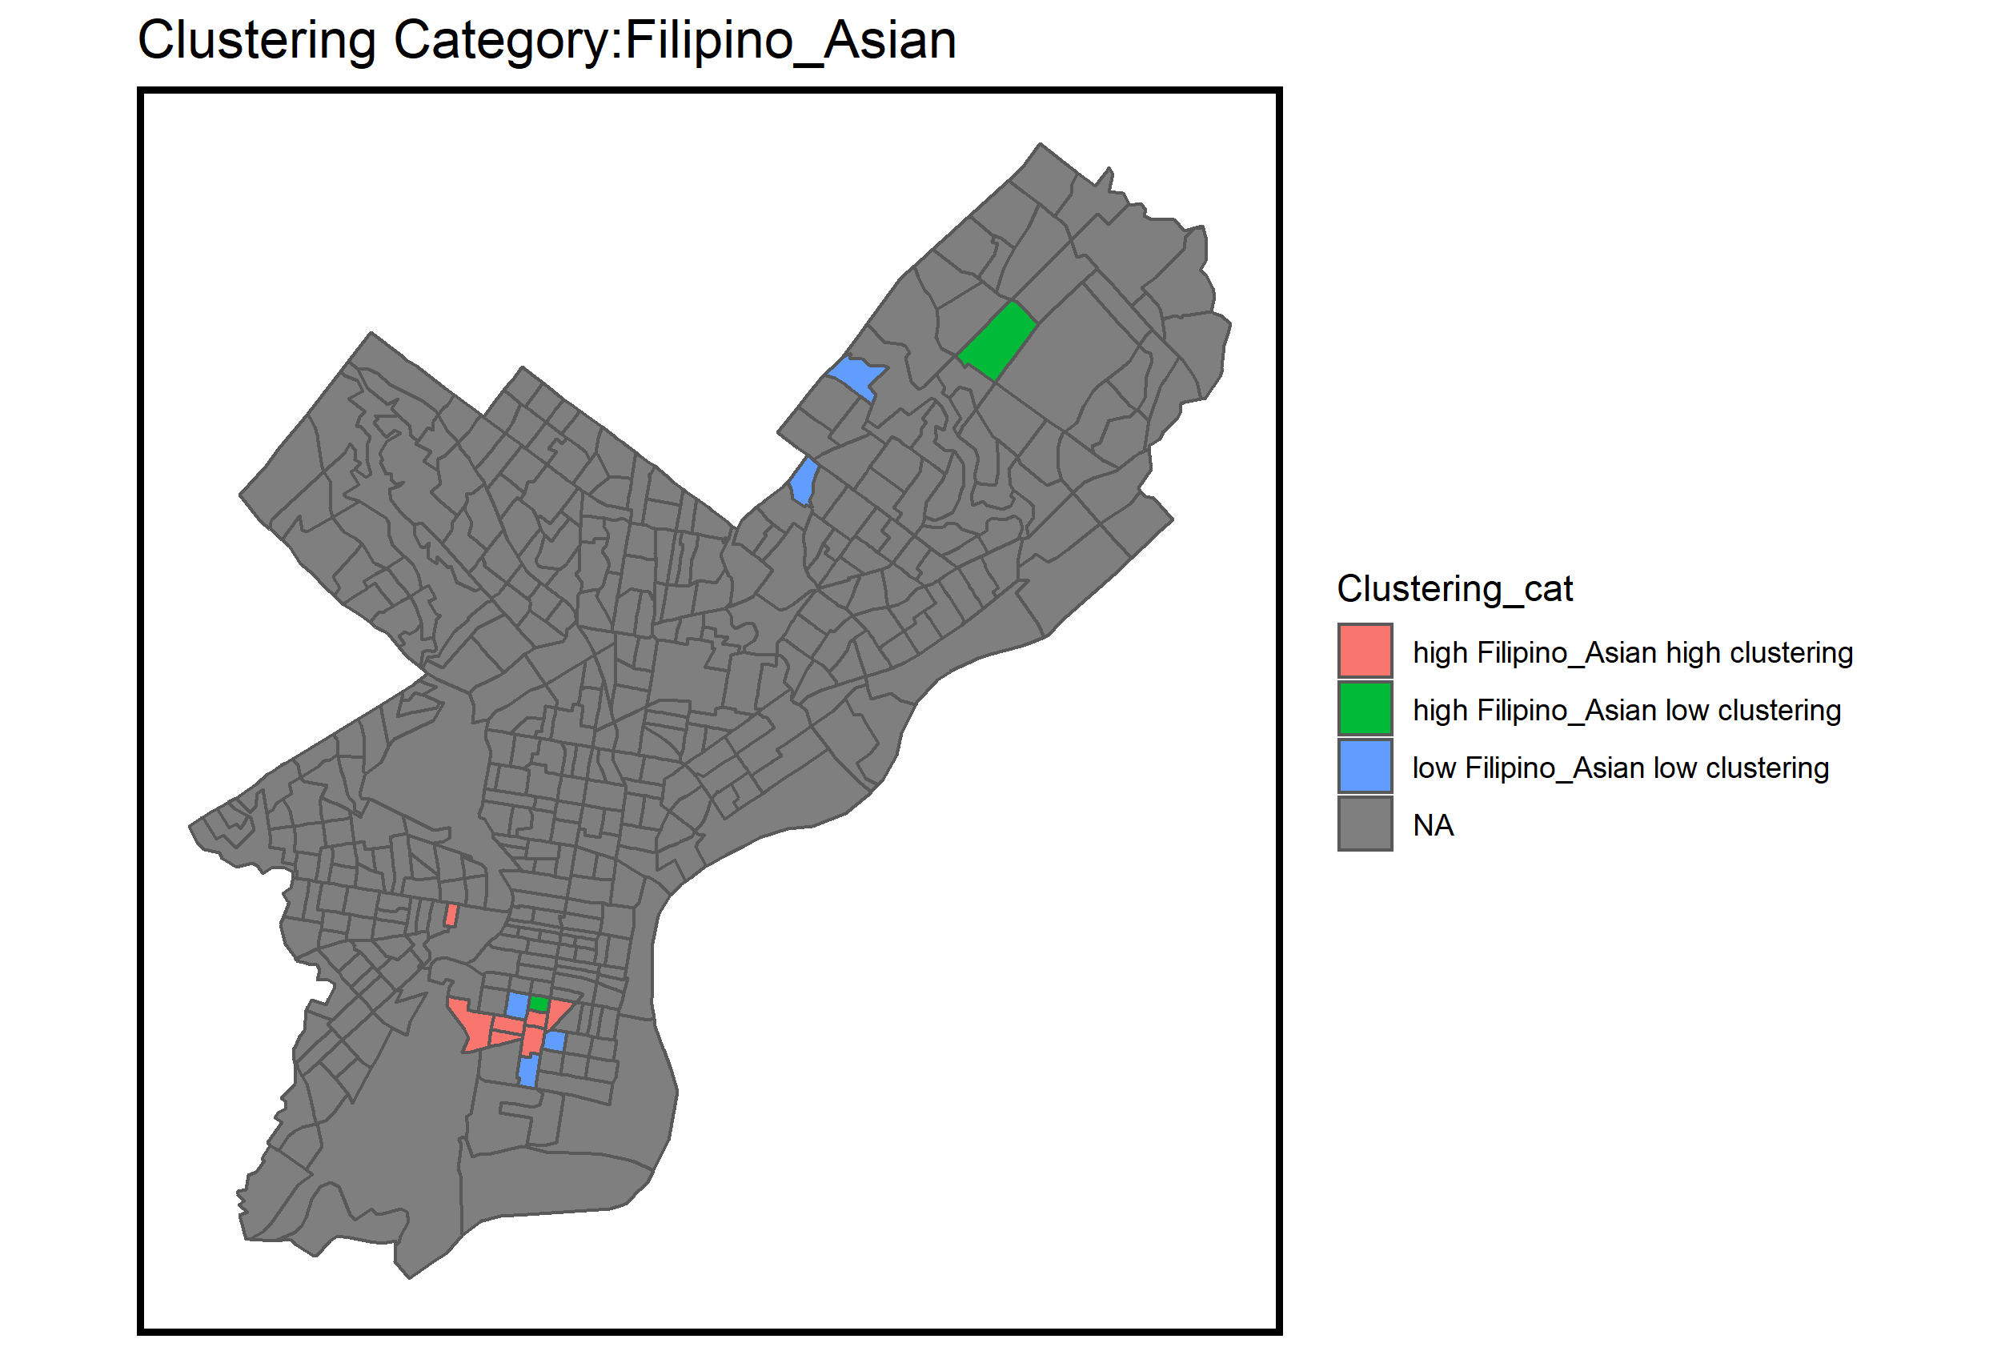
Moran’s I
Are Asian Americans Clustered?
Asian American PanEthnic Group Clustering

Slide 15
List of Methods: Kruskal-Wallis
Null Hypothesis: There is no statistically significant difference in means across unique high frequency, high clustered census tracts
Under normal assumptions, populations are normally distributed, and an ANOVA can be run to compare the groups means.
However, in the case with a small n, and non-parametric data a Kruskal-Wallis H test can be used instead. (Cohen, 2013)
Alternate Hypothesis: There is a statistically significant difference in means across unique high frequency, high clustered census tracts

Slide 16
Kruskal-Willis Significance
statistic | df | p | Variable
26.42965 | 4 | 7.75E-06 | Bachelor_more_Edu_Attainment
23.65325 | 4 | 2.95E-05 | Black_Race
22.38137 | 4 | 5.43E-05 | white_Race
16.95293 | 4 | 0.000723 | $100+K_Income
15.33399 | 4 | 0.00406 | Median gross rent Total
14.57941 | 4 | 0.00566 | Median income in the past 12 months Total
13.29585 | 4 | 0.00992 | Median earnings in the past 12 months Total
10.08841 | 4 | 0.017829 | Some_HS_or_less_Edu_Attainment

Slide 17
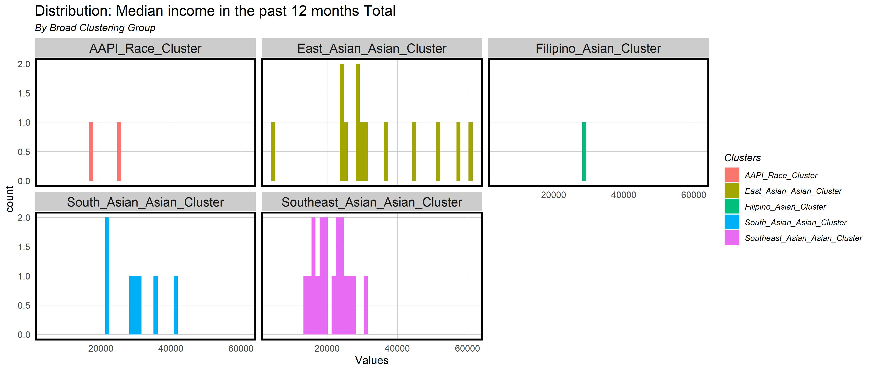
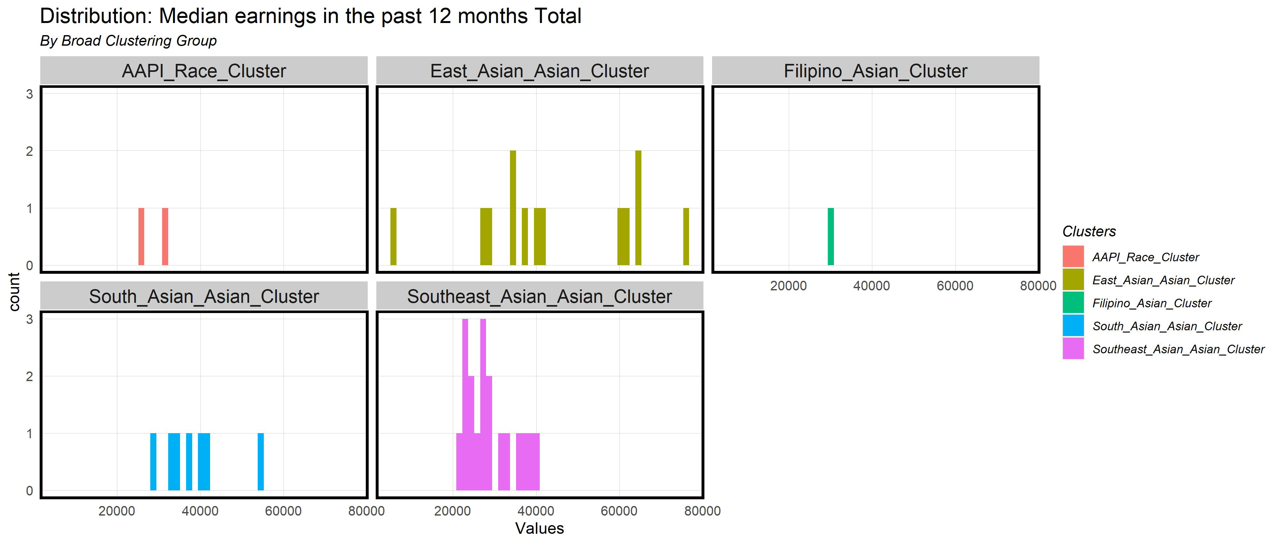
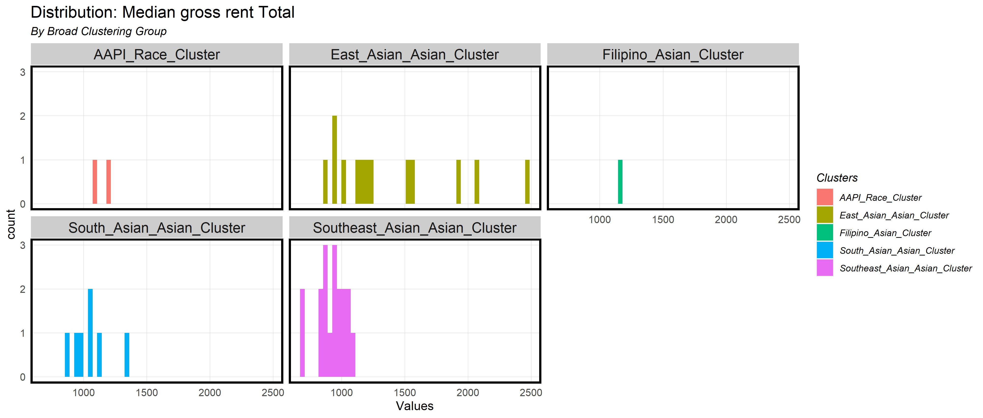
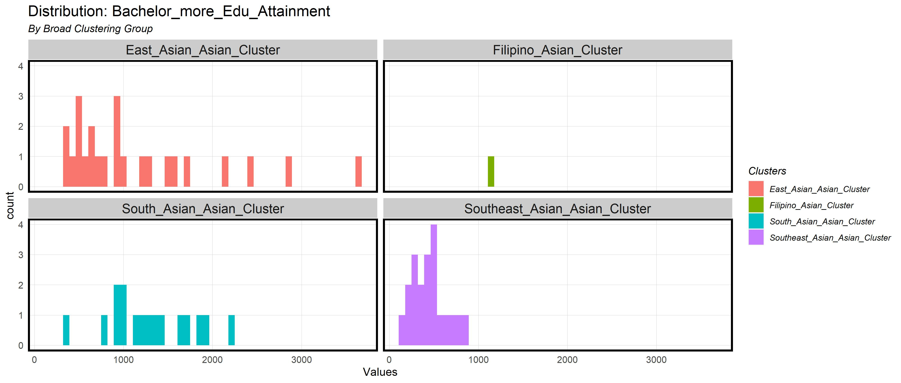
Asian American PanEthnic Distributions

Slide 18
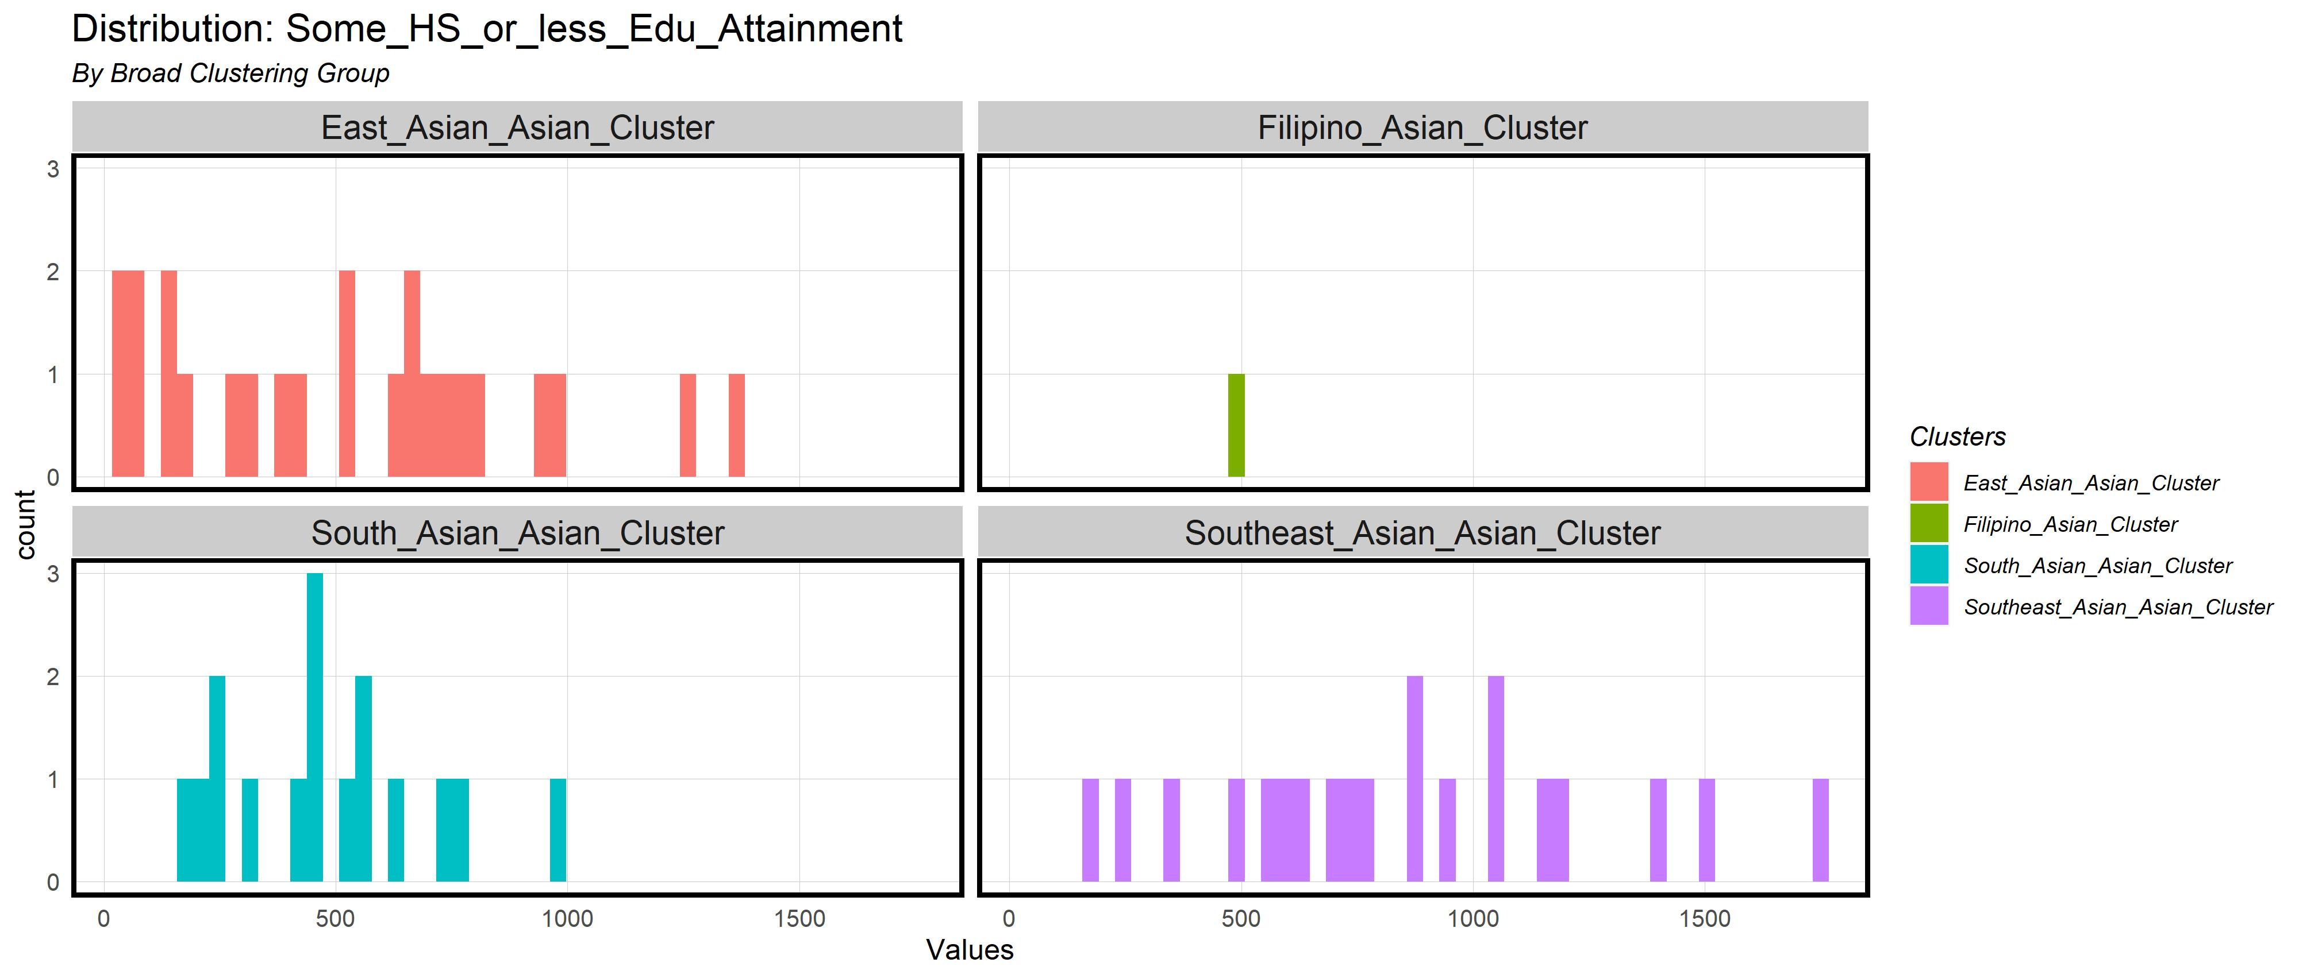
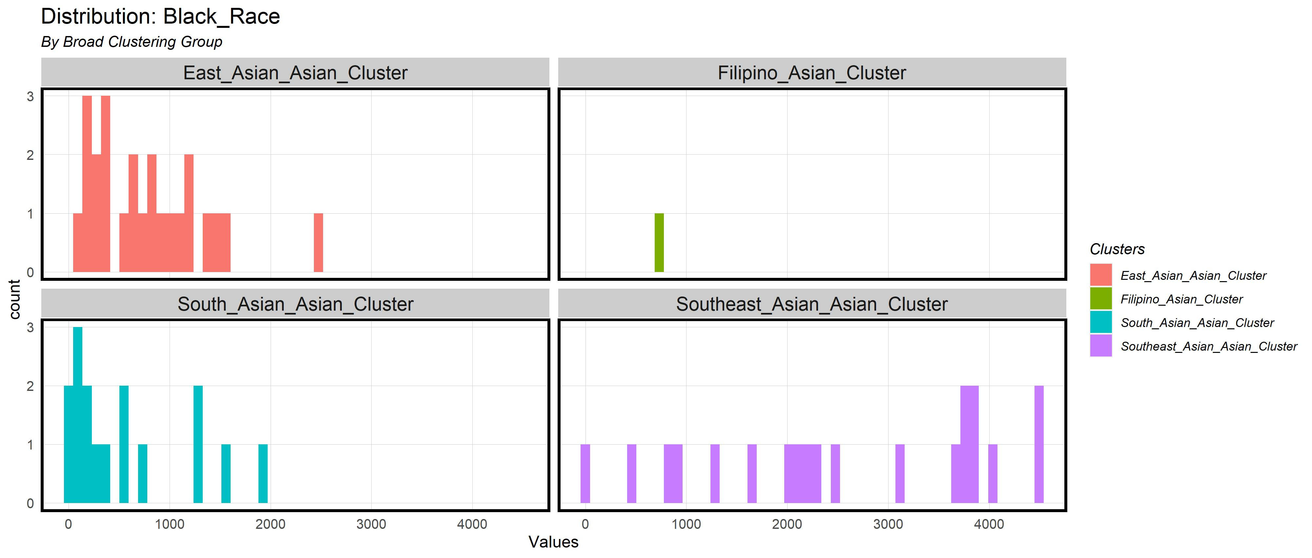
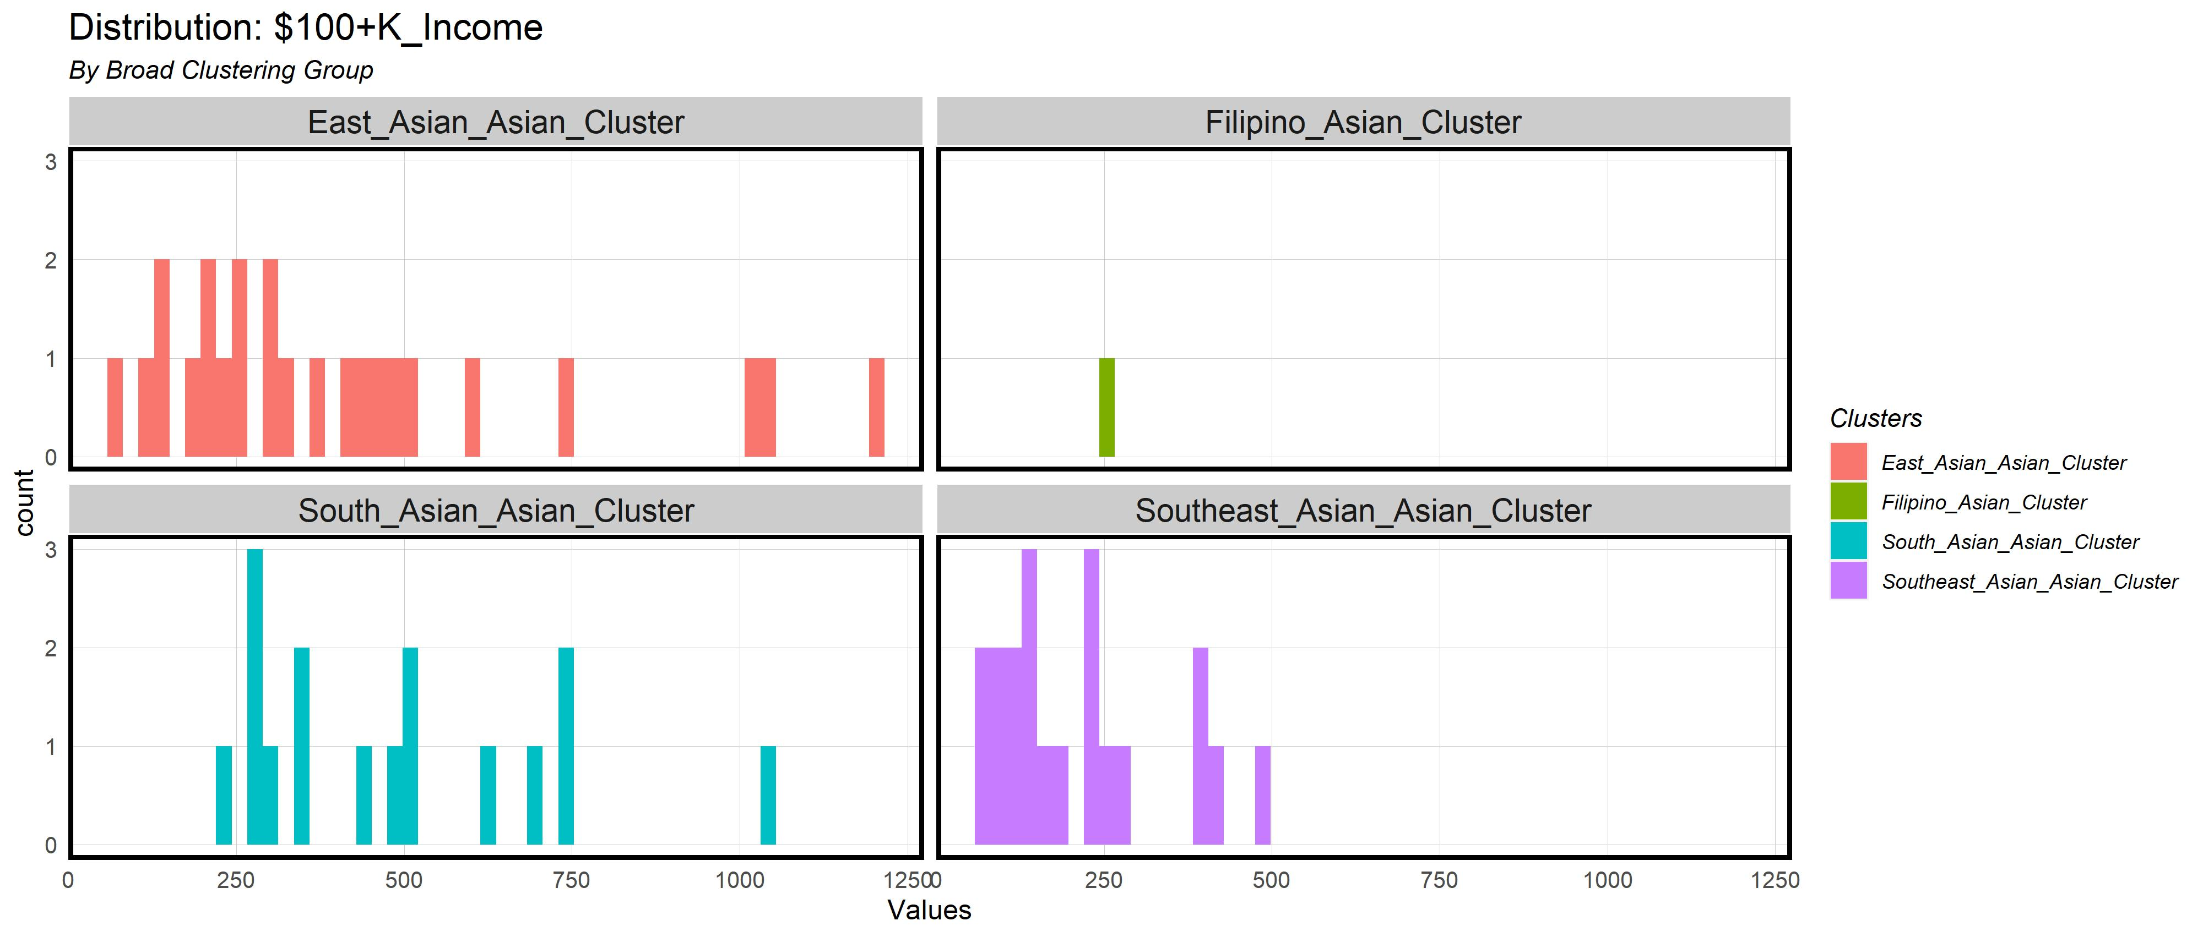
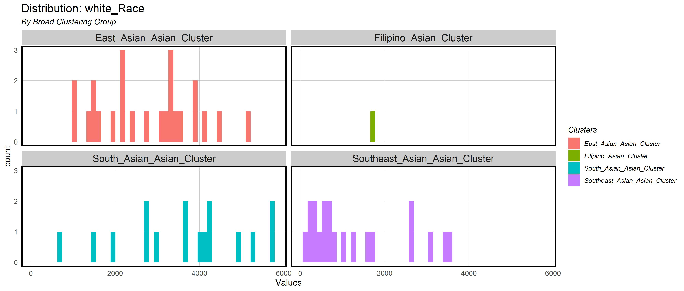
Asian American PanEthnic Distributions

Slide 19
List of Methods: Pairwise Wilcox
Null Hypothesis: There is no statistically significant difference in means across unique high frequency, high clustered census tracts
The pairwise Wilcox test indicates the direction of different between groups for non-parametric data. It test for differences between a list of groups.
This test shows which pairs are significantly different.
Alternate Hypothesis: There is a statistically significant difference in means across unique high frequency, high clustered census tracts

Slide 20
Kruskal-Willis Significance
group1 | group2 | n1 | n2 | p.adj | p.adj.signif | variable
Southeast_Asian_Asian_Cluster | South_Asian_Asian_Cluster | 20 | 16 | 6.12E-07 | ** | Bachelor_more_Edu_Attainment
Southeast_Asian_Asian_Cluster | South_Asian_Asian_Cluster | 20 | 16 | 8.16E-05 | ** | white_Race
Southeast_Asian_Asian_Cluster | South_Asian_Asian_Cluster | 20 | 16 | 9.92E-05 | ** | Black_Race
Southeast_Asian_Asian_Cluster | East_Asian_Asian_Cluster | 20 | 24 | 0.000151 | ** | Black_Race
Southeast_Asian_Asian_Cluster | East_Asian_Asian_Cluster | 20 | 24 | 0.000403 | ** | Bachelor_more_Edu_Attainment
Southeast_Asian_Asian_Cluster | South_Asian_Asian_Cluster | 20 | 16 | 0.000576 | ** | $100+K_Income
Southeast_Asian_Asian_Cluster | East_Asian_Asian_Cluster | 20 | 24 | 0.000602 | ** | white_Race
East_Asian_Asian_Cluster | Southeast_Asian_Asian_Cluster | 13 | 18 | 0.009 | ** | Median income in the past 12 months Total
East_Asian_Asian_Cluster | Southeast_Asian_Asian_Cluster | 13 | 18 | 0.015 | * | Median gross rent Total
Southeast_Asian_Asian_Cluster | East_Asian_Asian_Cluster | 20 | 24 | 0.016879 | * | $100+K_Income
Southeast_Asian_Asian_Cluster | South_Asian_Asian_Cluster | 20 | 16 | 0.018626 | * | Some_HS_or_less_Edu_Attainment
East_Asian_Asian_Cluster | Southeast_Asian_Asian_Cluster | 13 | 18 | 0.024 | * | Median earnings in the past 12 months Total
Southeast_Asian_Asian_Cluster | East_Asian_Asian_Cluster | 20 | 24 | 0.030792 | * | Some_HS_or_less_Edu_Attainment
South_Asian_Asian_Cluster | Southeast_Asian_Asian_Cluster | 7 | 18 | 0.031 | * | Median income in the past 12 months Total

Slide 21
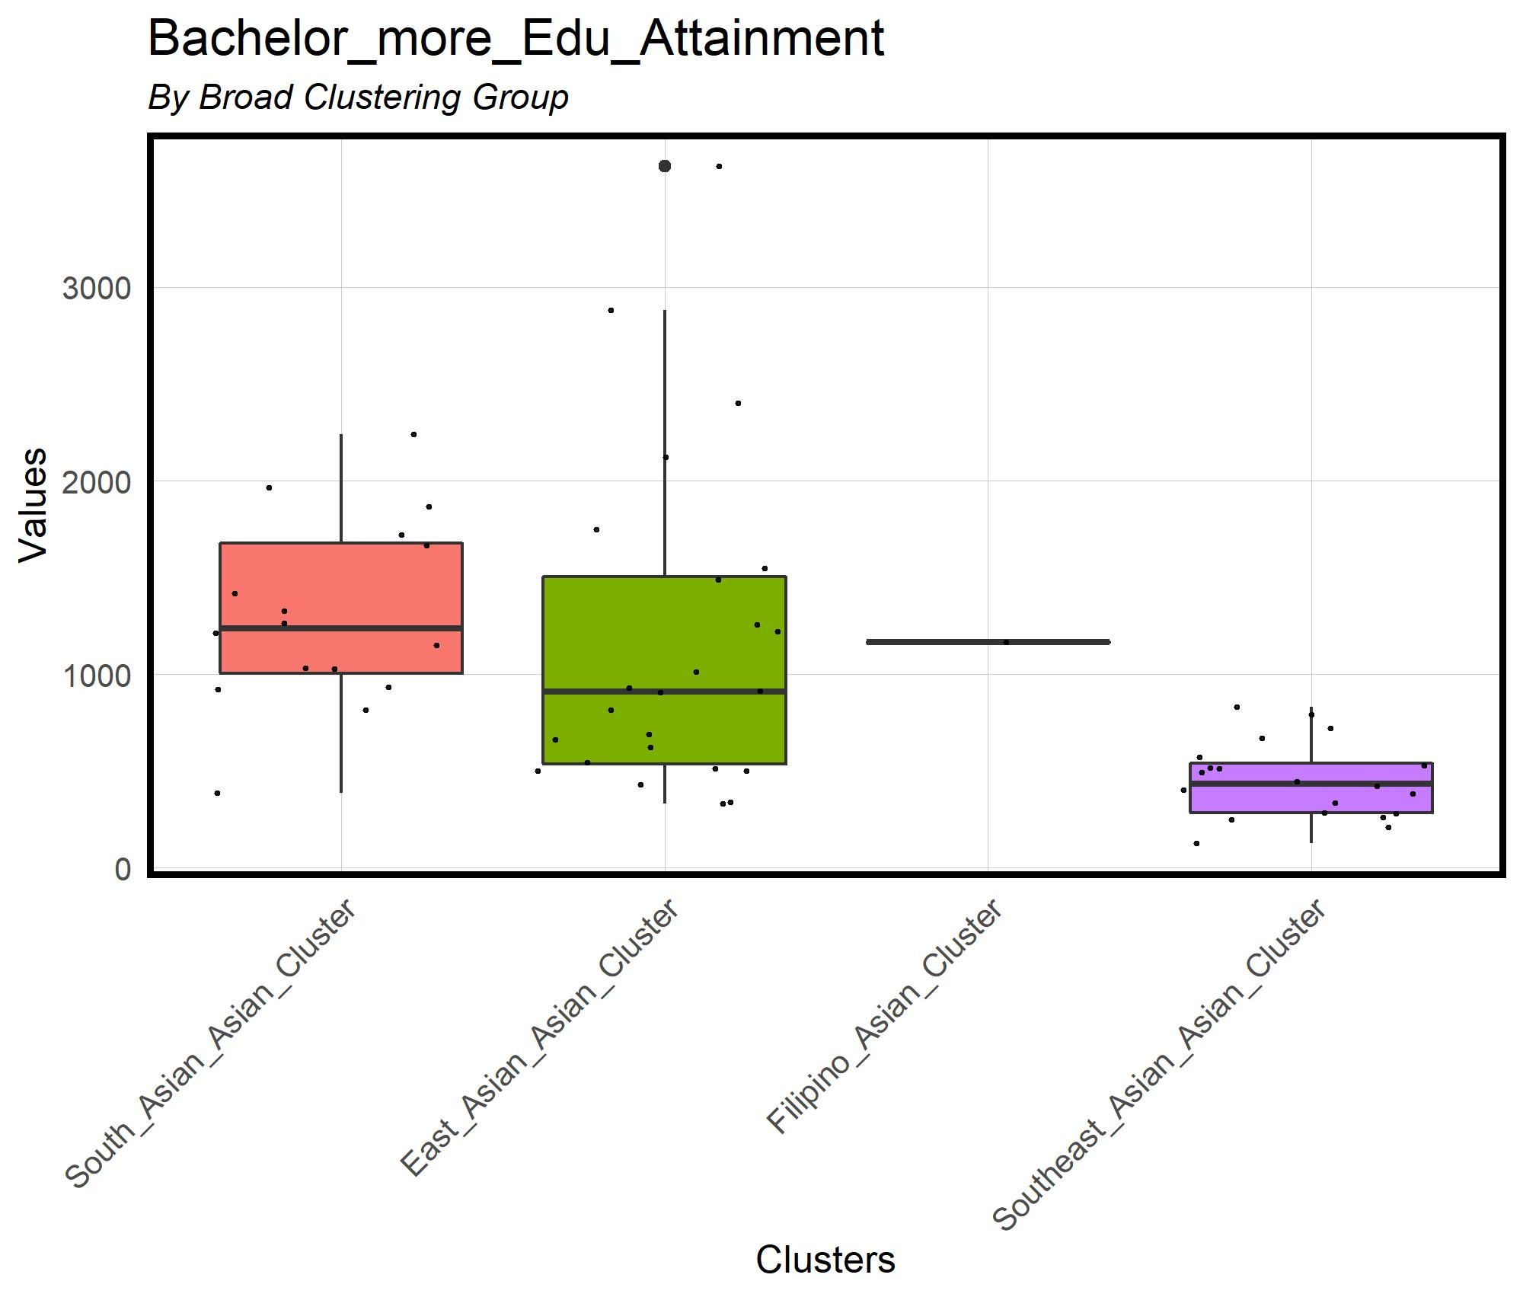
Asian American PanEthnic Group Clustering
Bachelor’s Degree Attainment

Slide 22
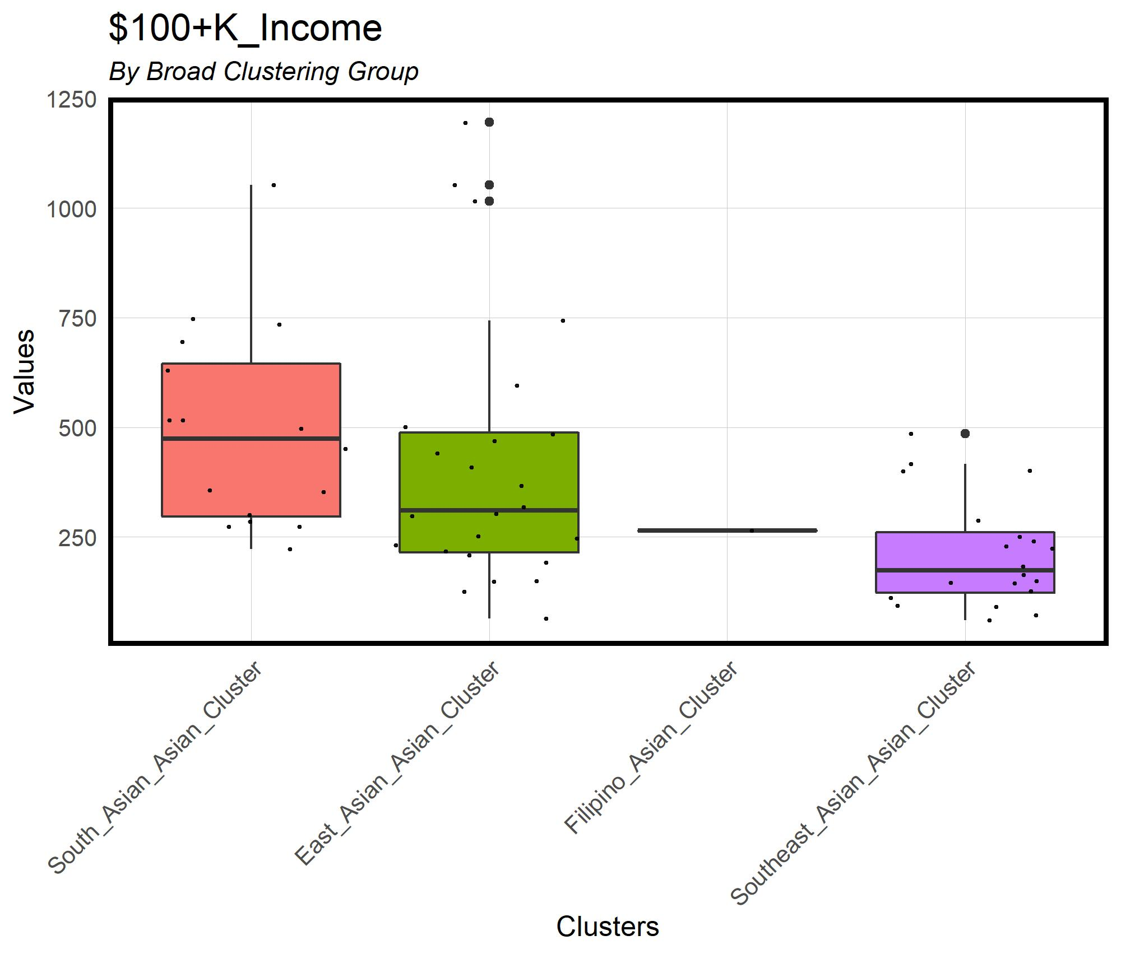
Asian American PanEthnic Group Clustering
100k+ or more

Slide 23
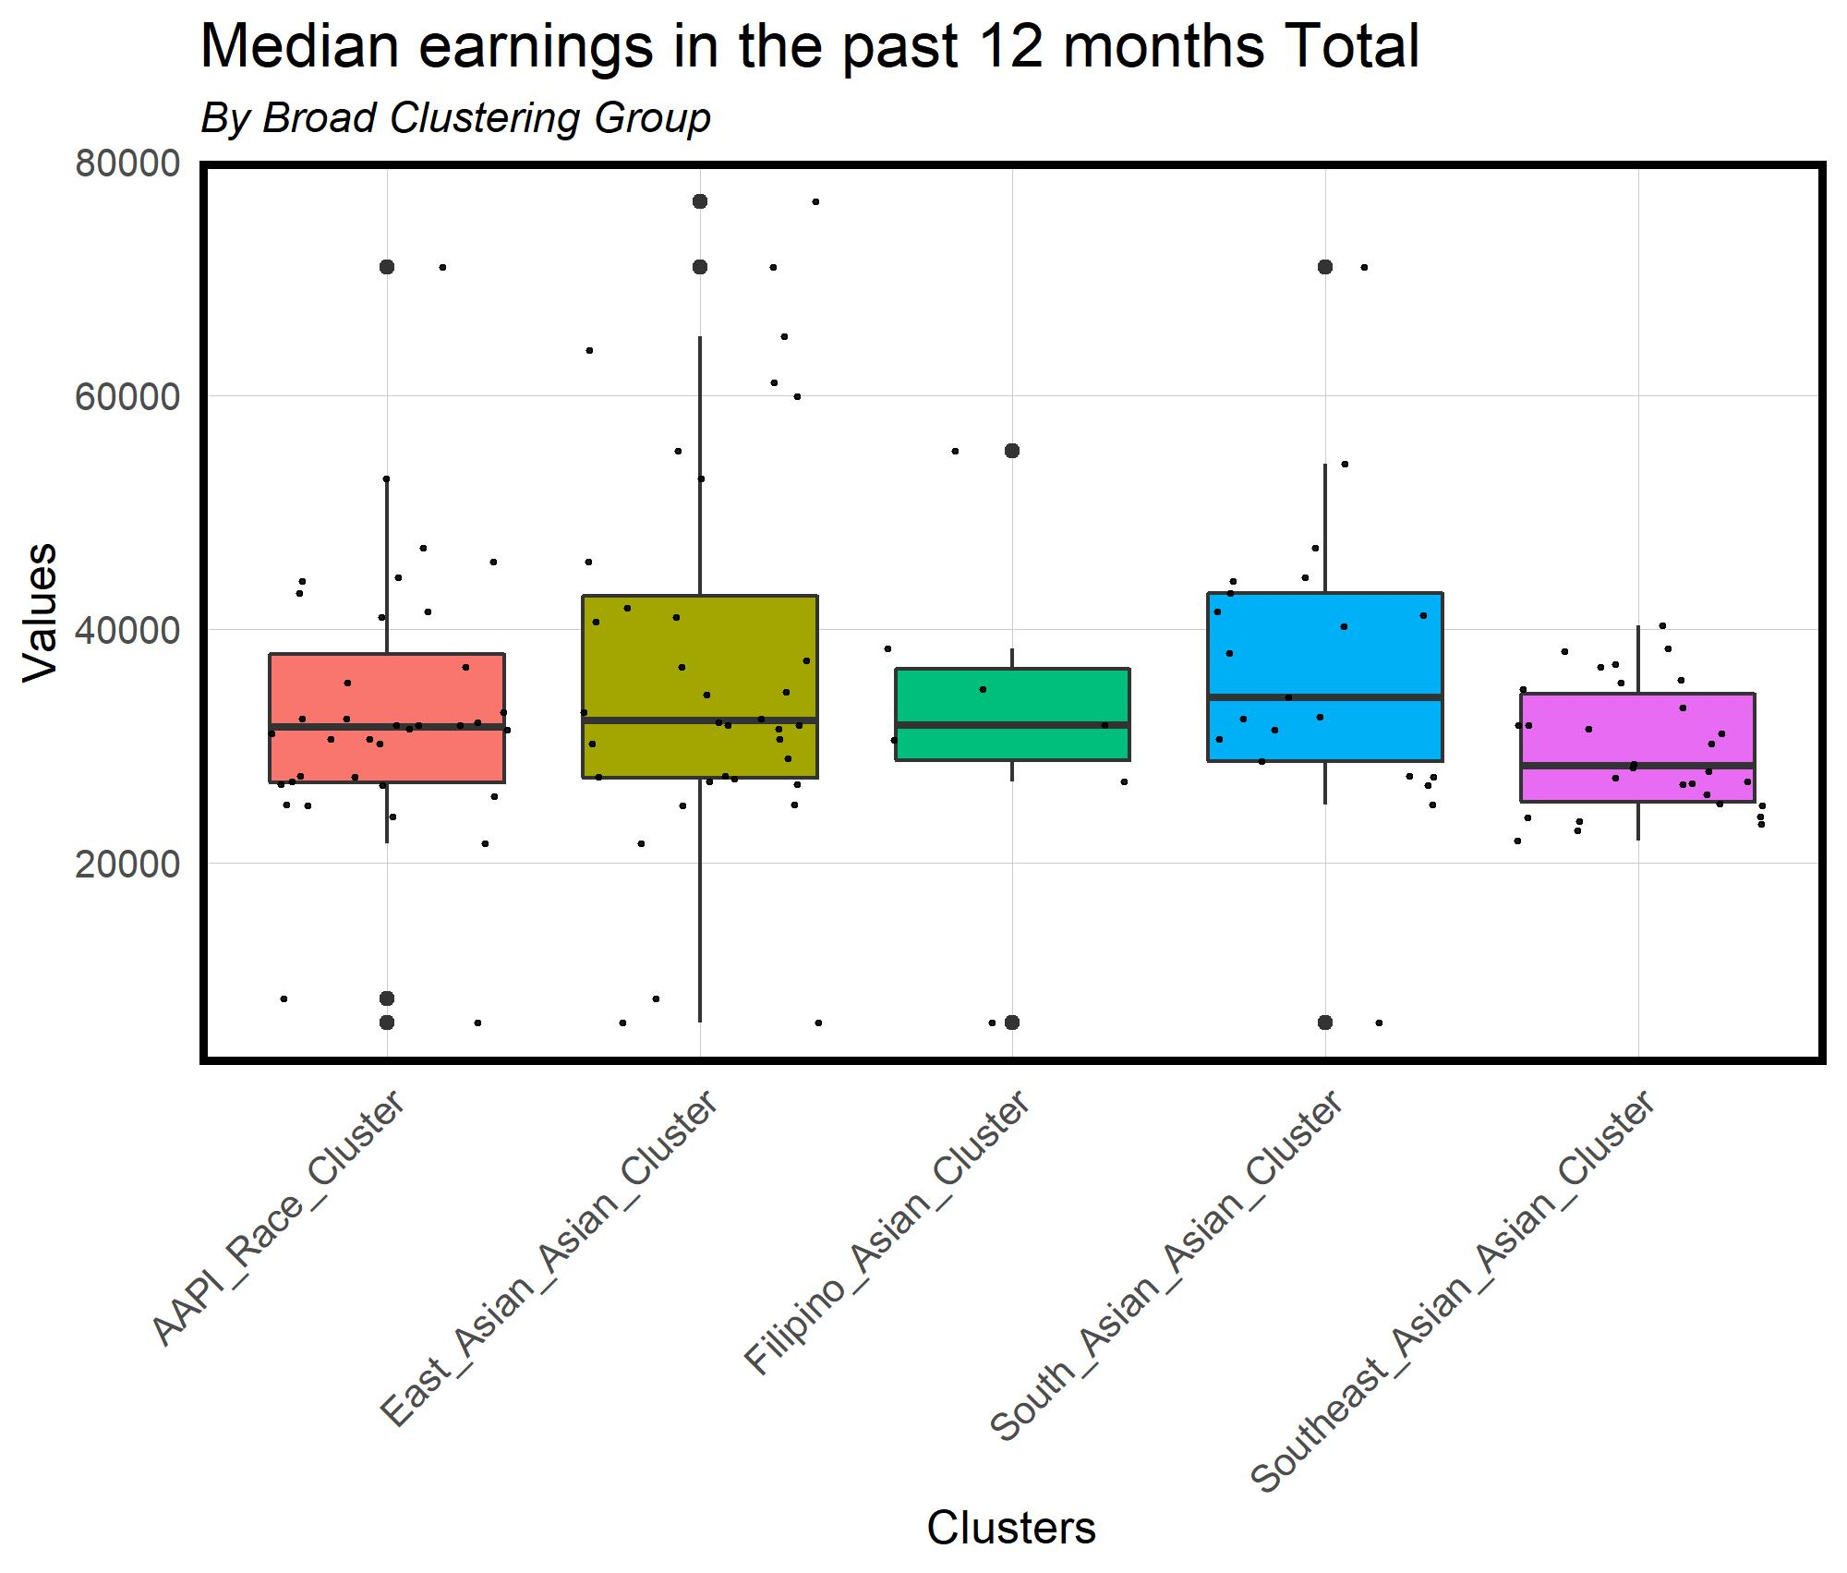
Asian American PanEthnic Group Clustering
Median Earnings in the past 12 months

Slide 24
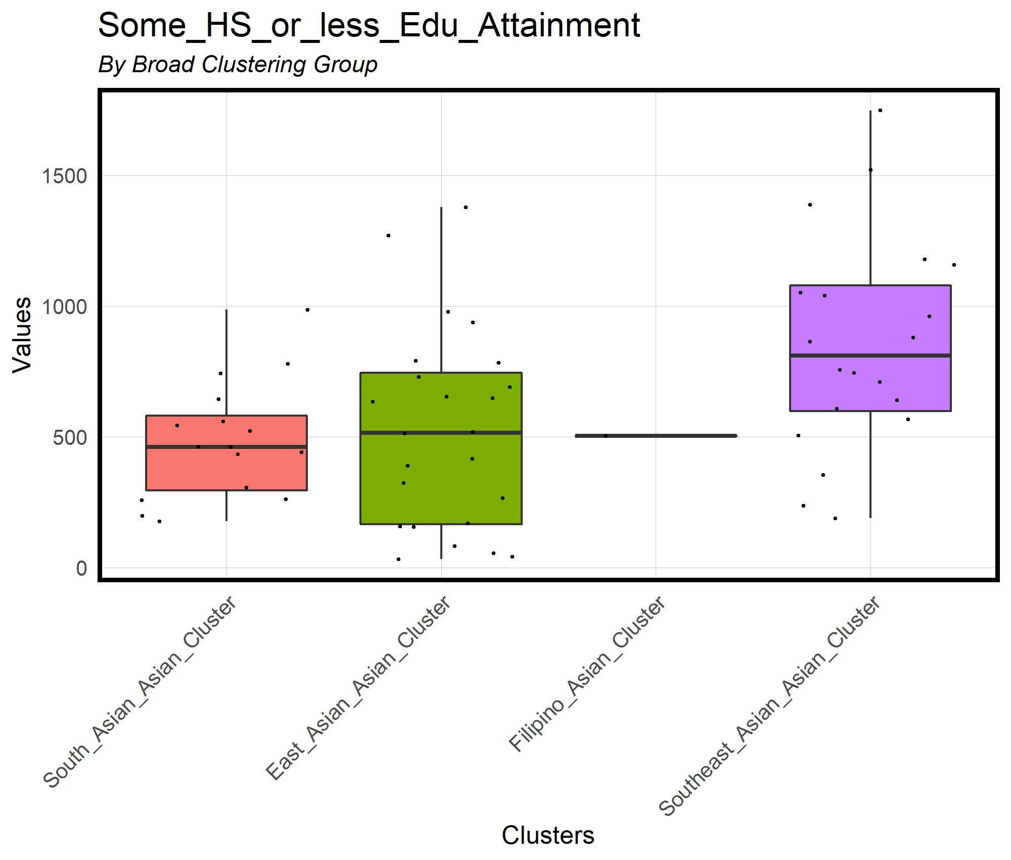
Asian American PanEthnic Group Clustering
High School or less

Slide 25
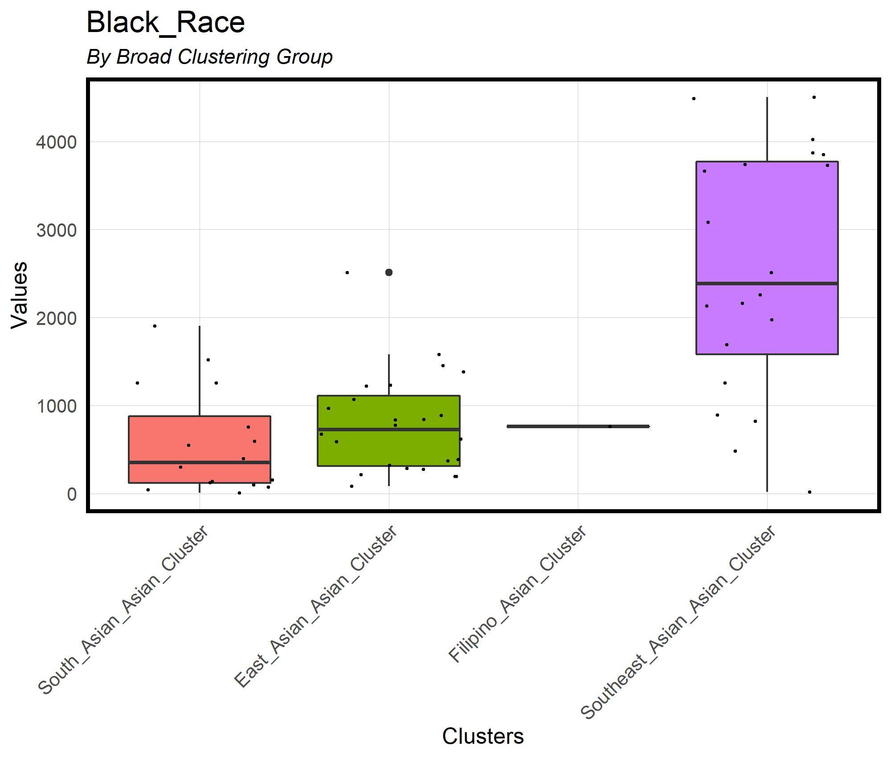
Asian American PanEthnic Group Clustering
Black Population

Slide 26
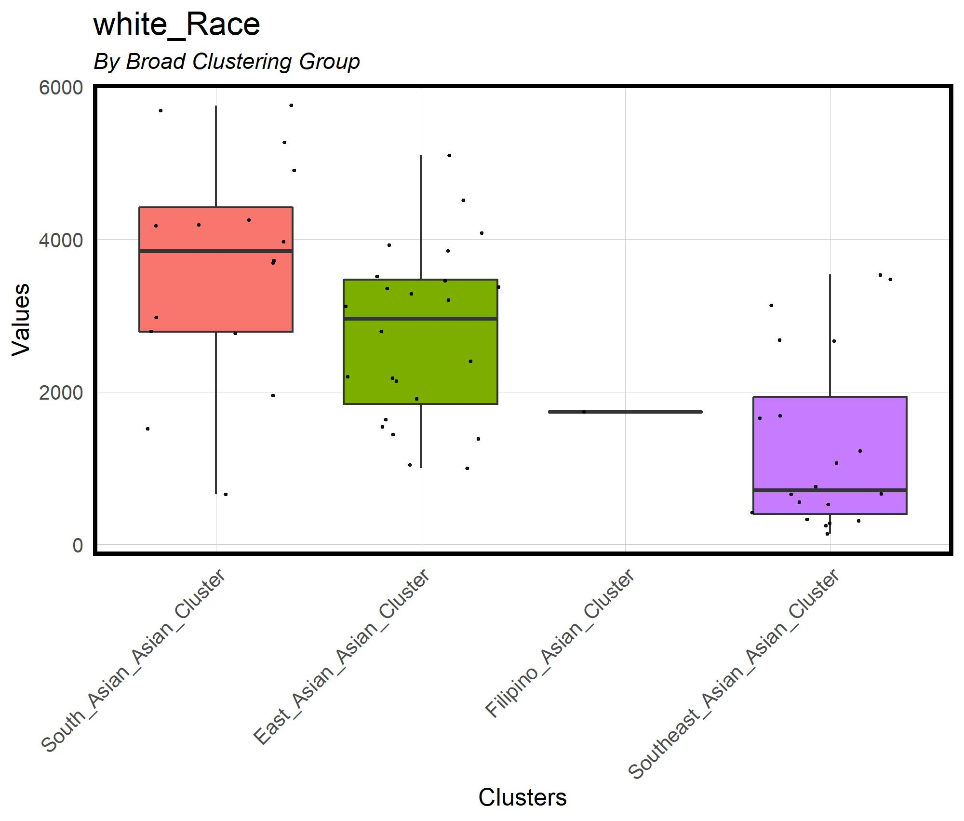
Asian American PanEthnic Group Clustering
White Population

Slide 27
Findings and Conclusions
Asian Americans are clustered across Philadelphia
There are areas where Asian Americans are uniquely located
There are statistically significant differences between broad ethnic group populations
Bachelors Attainment
People with $100k
Median Income
Differences are particularly pronounced between the following groups…
East Asians and Southeast Asians
South Asians and Southeast Asians

Slide 28
Implications for Practice
Be targeted and specific with your policies
There are different socioeconomic contexts across philadelphia
When working with Asian American data be specific
Asian Americans come from a variety of different environments,
Although there are environmental differences between Asian Americans, there is still importance in a panethnic political identity

Slide 29
Future Questions
How do Asian Americans operate in Black geographies (Dache, 2022; McKittrick & Woods, 2007) or White geographies (Dache-Gerbino & White, 2016; Hargrove, 2009).
There are differences in the geographies, but how do these geographies shape individual student success?
Dache (2016), argues that black communities have less access, how does this apply to Asian Americans in Black geographies?

